Slide 1
The Next

Slide 2
Disposition
Introduktion
De 4 P’er
People
Rollefordeling
Product
Geolokation/API
Project
Udviklingsmodellen
Process
Function points
Quality assurance
Demonstration
Notes:
Casper: Project
Patrick: Product
Matthias: Intro & People
Christian: Process

Slide 3
People

Slide 4
Product

Slide 5
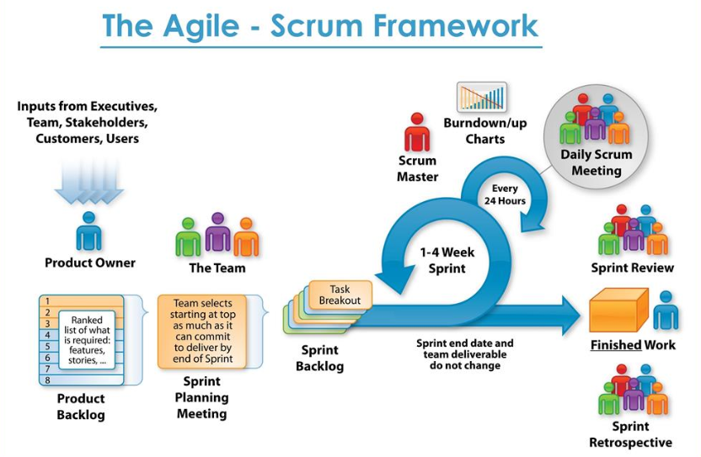
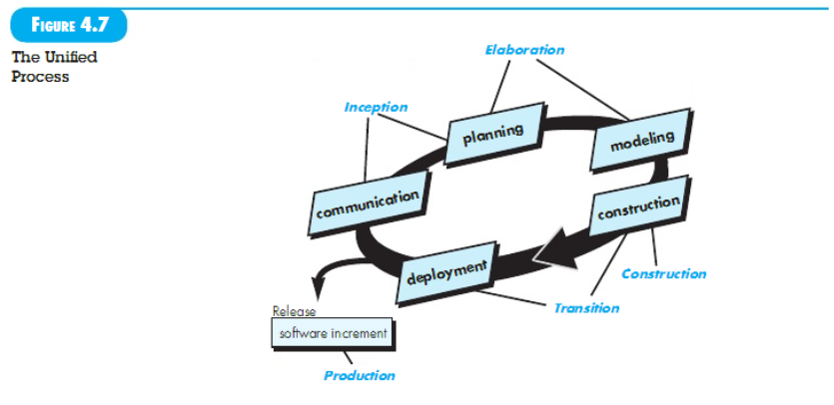
Project
VS
Fordele:
Ulemper:
Fordele:
Ulemper:

Slide 6
Process

